Slide 1
ETHICAL HACKING
JOHN MCGARVEY

Slide 2
IN THIS LECTURE
Sec, Fx, Ease of use triangle
Ethical Hacker skillset
Vulnerability assessment
3 Ps
Vulnerability Research
Ethical Hacking/Pentesting
Security Audits
Security Evaluation Plan
Types of Ethical Hacks
Testing types
Ethical Hacking reports
Legal implications

Slide 3
SECURITY, FUNCTIONALITY, AND EASE OF USE TRIANGLE
As a security professional, it’s difficult to strike a balance between adding security barriers to prevent an attack and allowing the system to remain functional for users.
The security, functionality, and ease of use triangle is a representation of the balance between security and functionality and the system’s ease of use for users

Slide 4
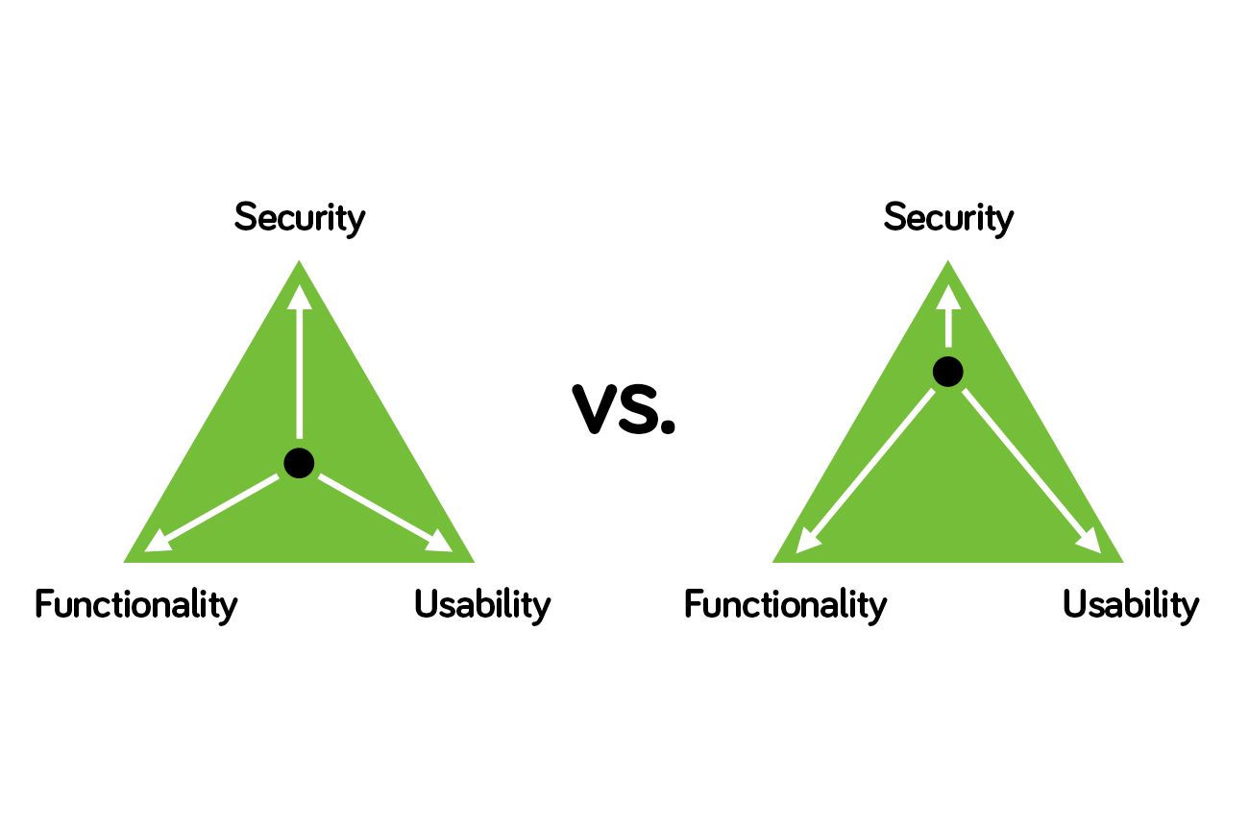
THE TRIANGLE
In general, as security increases, the system’s functionality and ease of use decrease for users.

Slide 5
THE TRIANGLE
In an ideal world, security professionals would like to have the highest level of security on all systems, However many security barriers make it difficult for users to use the system and impede the system’s functionality.
Suppose that in order to gain entry to your office at work you had to
  first pass through a guard checkpoint at the entrance to the car park to verify your vehicle number plate
  Show a badge to door security as you entered the building
  Use a passcode to gain entry to the elevator
  Finally use a key/swipe-card to unlock your office door.
You might feel the security checks were too stringent!
  Any one of those checks could cause you to be detained and consequently miss an important meeting

Slide 6

DEFINING THE SKILLS REQUIRED TO BE AN ETHICAL HACKER
Computing and Networking skills
  Ethical hackers who stay a step ahead of malicious hackers must be computer systems experts who are very knowledgeable about
  Computer programming
  Computer networks
  Operating systems
In-depth knowledge about highly targeted platforms (such as Windows, Unix, and Linux) is also a requirement.
Perhaps the most important skill is to read up regularly about Cybersecurity vulnerabilities. Keep yourself informed about the most recent attacks and vulnerabilities. Follow cybersecurity people on twitter.
  @mikko, @kevinmitnick

Slide 7
ETHICAL HACKER SKILLS- THE 3 PS
Patience – taking time to gather information about a target
Persistence/Perseverance – sticking with a task until you get the desired result or information.
All are important qualities that many hackers possess because of the length of time and level of concentration required for most attacks/compromises to pay off.
Most ethical hackers are knowledgeable about security areas and related issues but don’t necessarily have a strong command of the countermeasure that can prevent attacks.

Slide 8

WHAT IS VULNERABILITY RESEARCH?
Is the process of discovering vulnerabilities and design weaknesses that could lead to an attack on a system.
Several websites and tools exist to aid the ethical hacker in maintaining a current list of vulnerabilities and possible exploits for their systems or networks.
It’s essential that a systems administrator keep current on the latest viruses, Trojans, and other common exploits in order to adequately protect their systems and network.
Also, by becoming familiar with the newest threats, an administrator can learn how to detect, prevent and recover from an attack.

Slide 9

ETHICAL HACKING/PENTESTING
Ethical hacking is usually conducted in a structured and organized manner, usually as part of a penetration test or security audit.
The depth and breadth of the systems and applications to be tested are usually determined by the needs and concerns of the client.
Many ethical hackers are members of a tiger team
  Red Team – attempting to identify and exploit potential weaknesses within the company cyber defenses using technical and sophisticated attacks
  Blue Team – play on the defense, incident response who provide guidance to the IT security team to make improvements to stop complex attacks
  https://www.crowdstrike.com/epp-101/red-team-vs-blue-team/

Slide 10
THE STEPS FOR PERFORMING A SECURITY AUDIT OF AN ORGANIZATION
Talk to the client, and discuss the needs to be addressed during the testing.
Prepare and sign nondisclosure agreement (NDA) documents with the client.
Organize an ethical hacking team, and prepare a schedule for testing.
Conduct the test.
Analyze the results of the testing, and prepare a report.
Present the report to the client.

Slide 11
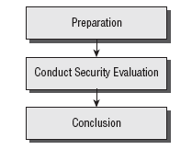
CREATING A SECURITY EVALUATION PLAN
Many ethical hackers acting in the role of security professionals use their skills to perform security evaluations or penetration tests. These tests and evaluations have three phases, generally ordered as follows:

Slide 12
CREATING A SECURITY EVALUATION PLAN
The Preparation phase involves a formal agreement between the ethical hacker and the organization.
This agreement should include the full scope of the test, the types of attacks (inside or outside) to be used, and the testing types: white, black, or grey box.

Slide 13
TYPES OF ETHICAL HACKS
Ethical hackers can use many different methods to breach an organization’s security during a simulated attack or penetration test.
Remote network A remote network hack attempts to simulate an intruder launching an attack over the Internet. The ethical hacker tries to break or find a vulnerability in the outside defenses of the network, such as firewall, proxy, or router vulnerabilities.

Slide 14
TYPES OF ETHICAL HACKS
Local network
  A local network hack simulates someone with physical access gaining additional unauthorized access using the local network.
  The ethical hacker must gain direct access to the local network in order to launch this type of attack.
Stolen equipment
  A stolen-equipment hack simulates theft of a critical information resource such as a laptop owned by an employee.
  Information such as usernames, passwords, security settings, and encryption types can be gained by stealing a laptop.

Slide 15
TYPES OF ETHICAL HACKS
Social engineering
  A social-engineering attack checks the integrity of the organization’s employees by using the telephone or face-to-face communication to gather information for use in an attack.
  Social engineering attacks can be used to acquire usernames, passwords, or other organizational security measures.
Physical entry
  A physical-entry attack attempts to compromise the organization’s physical premises.
  An ethical hacker who gains physical access can plant viruses, Trojans, rootkits, or hardware key loggers (physical device used to record keystrokes) directly on systems in the target network.

Slide 16
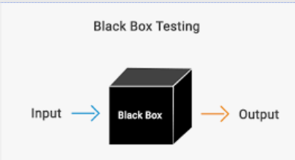
TESTING TYPES
When performing a security test or penetration test, an ethical hacker utilizes one or more types of testing on the system.
Each type simulates an attacker with different levels of knowledge about the target organization.
3 Types exist, Black, White and Grey box testing.
Black box
  Black-box testing involves performing a security evaluation and testing with no prior knowledge of the network infrastructure or system to be tested.
  Testing simulates an attack by a malicious hacker outside the organization’s security perimeter.

Slide 17
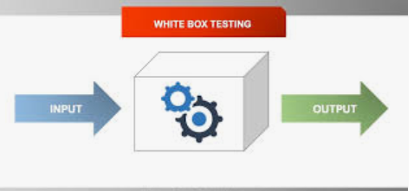
TESTING TYPES
White box - involves performing a security evaluation and testing with complete knowledge of the network infrastructure such as a network administrator would have.
Grey box Grey-box testing involves performing a security evaluation and testing internally. Testing examines the extent of access by insiders within the network.

Slide 18
ETHICAL HACKING REPORT
The result of a network penetration test or security audit is an ethical hacking report.
This report details the results of the hacking activity, the types of tests performed, and the hacking methods used.
These results are compared against the work scheduled prior to the Conduct Security Evaluation phase.
Any vulnerabilities identified are detailed, and countermeasures are suggested.

Slide 19
ETHICAL HACKING REPORT
This document is usually delivered to the organization in hard-copy format, for security reasons.
The details of the ethical hacking report must be kept confidential, because they highlight the organization’s security risks and vulnerabilities.
If this document falls into the wrong hands, the results could be disastrous for the organization.

Slide 20
UNDERSTANDING THE LEGAL IMPLICATIONS OF HACKING
An ethical hacker should know the penalties of unauthorized hacking into a system.
No ethical hacking activities associated with a network-penetration test or security audit should begin until a signed legal document giving the ethical hacker express permission to perform the hacking activities is received from the target organization.
Ethical hackers need to be judicious with their hacking skills and recognize the consequences of misusing those skills

Slide 21
UNDERSTANDING THE LEGAL IMPLICATIONS
OF HACKING
Computer crimes can be broadly categorized into two categories:
  Crimes facilitated by a computer
  Crimes where the computer is the target.
The two most important U.S. laws regarding computer crimes are described in the following section.
Remember, intent doesn’t make a hacker above the law; even an ethical hacker can be prosecuted for breaking these laws.

Slide 22
LEGAL IMPLICATIONS
The Cyber Security Enhancement Act of 2002 mandates life sentences for hackers who “wrecklessly” endanger the lives of others.
Malicious hackers who create a life-threatening situation by attacking computer networks for transportation systems, power companies, or other public services or utilities can be prosecuted under this law.

Slide 23
UNDERSTANDING 18 U.S.C. § 1029 &1030 U.S. FEDERAL LAW
The U.S. Code categorizes and defines the laws of the United States by titles. Title 18 details “Crimes and Criminal Procedure.”
Section 1029, “Fraud and related activity in connection with access devices,”
  States that if you produce, sell, or use counterfeit access devices or telecommunications instruments with intent to commit fraud and obtain services or products with a value or $1,000, you have broken the law.
Section 1029 criminalizes the misuse of computer passwords and other access devices such as token cards.
Section 1030, “Fraud and related activity in connection with computers,”
  Prohibits accessing protected computers without permission and causing damage.
  This statute criminalizes the spreading of viruses and worms and breaking into computer systems by unauthorized individuals.

Slide 24
REVIEW
Understand essential hacker terminology. Make sure you’re familiar with and can define the terms threat, exploit, vulnerability, target of evaluation, and attack.
Understand the difference between ethical hackers and crackers. Ethical hackers are security professionals who act defensively. Crackers are malicious hackers who choose to inflict damage on a target system.
Know the classes of hackers. It’s critical to know the differences among black-hat, whitehat, and grey-hat hackers for the exam. Know who the good guys are and who the bad guys are in the world of hacking.
Know the phases of hacking. Passive and active reconnaissance, scanning, gaining access, maintaining access, and covering tracks are the five phases of hacking. Know the order of the phases and what happens during each phase.
Be aware of the types of attacks. Understand the differences between active and passive and inside and outside attacks. The ability to be detected is the difference between active and passive attacks. The location of the attacker is the difference between inside and outside attacks.
Know the ethical hacking types. Hackers can attack the network from a remote network, a remote dial-up network, or a local network, or through social engineering, stolen equipment, or physical access.

Slide 25
REVIEW QUESTIONS
1. Which of the following statements best describes a white-hat hacker?
A. Security professional
B. Former black hat
C. Former grey hat
D. Malicious hacker
2. A security audit performed on the internal network of an organization by the network administration
is also known as ___________.
A. Grey-box testing
B. Black-box testing
C. White-box testing
D. Active testing
E. Passive testing
3. What is the first phase of hacking?
A. Attack
B. Maintaining access
C. Gaining access
D. Reconnaissance
E. Scanning

Slide 26
REVIEW QUESTIONS
4. What type of ethical hack tests access to the physical infrastructure?
A. Internal network
B. Remote network
C. External network
D. Physical access
5. The security, functionality, and ease of use triangle illustrates which concept?
A. As security increases, functionality and ease of use increase.
B. As security decreases, functionality and ease of use increase.
C. As security decreases, functionality and ease of use decrease.
D. Security does not affect functionality and ease of use.
6. Which type of hacker represents the highest risk to your network?
A. Disgruntled employees
B. Black-hat hackers
C. Grey-hat hackers
D. Script kiddies

Slide 27
REVIEW QUESTIONS
7. What are the three phases of a security evaluation plan? (Choose three answers.)
A. Conduct Security Evaluation
B. Preparation
C. Conclusion
D. Final
E. Reconnaissance
F. Design Security
G. Vulnerability Assessment
8. Hacking for a cause is called __________________.
A. Active hacking
B. Hacktivism
C. Activism
D. Black-hat hacking
9. Which federal law is most commonly used to prosecute hackers?
A. Title 12
B. Title 18
C. Title 20
D. Title 2

Slide 28
REVIEW QUESTIONS
10. When a hacker attempts to attack a host via the Internet it is known as what type of attack?
A. Remote attack
B. Physical access
C. Local access
D. Internal attack

Slide 29
ANSWERS TO REVIEW QUESTIONS
1. A. Explanation: A white-hat hacker is a “good” guy who uses his skills for defensive purposes.
2. C. Explanation: White-box testing is a security audit performed with internal knowledge of the systems.
3. D. Explanation: Reconnaissance is gathering information necessary to perform the attack.
4. D. Explanation: Physical access tests access to the physical infrastructure.
5. B. Explanation: As security increases it makes it more difficult to use and less functional.

Slide 30
ANSWERS TO REVIEW QUESTIONS
6. A. Explanation: Disgruntled employees have information which can allow them to launch a
powerful attack.
7. A, B, C. Explanation: The three phases of a security evaluation plan are preparation, conduct
security evaluation, and conclusion.
8. B. Explanation: Hacktivism is performed by individual who claim to be hacking for a political
or social cause.
9. B. Explanation: Title 18 of the U.S. Code of law is most commonly used to prosecute hackers
10. A. Explanation: An attack from the Internet is known as a remote attack.

